Slide 1

Visión por Computador
Domingo Mery
Departamento de Ciencia de la Computación
Escuela de Ingeniería
Universidad Católica de Chile
Federated / Swarm Learning

Slide 2
MACHINE LEARNING
DATABASE
CNN
Accuracy

Slide 3
SEPARATED LEARNING
DATABASE A
DATABASE B
DATABASE C
CNN
CNN
CNN
Accuracy-A
Accuracy-B
Accuracy-C

Slide 4
FULL LEARNING (training)
DATABASE A+B+C
CNN
Accuracy-F

Slide 5
FULL LEARNING (testing)
DATABASE A+B+C
DATABASE A
DATABASE B
DATABASE C
CNN
CNN
CNN
CNN
(trained)
(trained)
(trained)
(trained)
Accuracy-F
Accuracy-A
Accuracy-B
Accuracy-C

Slide 6
FEDERATED LEARNING
DATABASE A
DATABASE B
DATABASE C
CNN
CNN
CNN
weights
weights
weights
Server Central
Accuracy-F

Slide 7
SWARM LEARNING (training)
DATABASE A
DATABASE B
DATABASE C
CNN
weights
CNN
weights
CNN
weights

Slide 8
SWARM LEARNING (training)
DATABASE A
DATABASE B
DATABASE C
CNN
CNN
CNN

Slide 9
SWARM LEARNING (testing)
DATABASE A
DATABASE B
DATABASE C
CNN
CNN
CNN
(trained)
(trained)
(trained)
Accuracy-A*
Accuracy-B*
Accuracy-C*

Slide 10
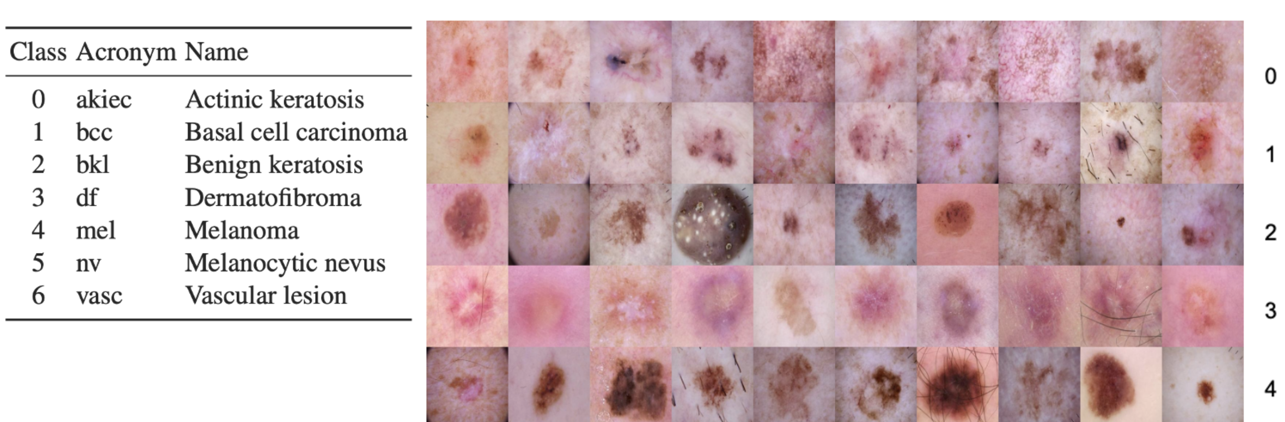
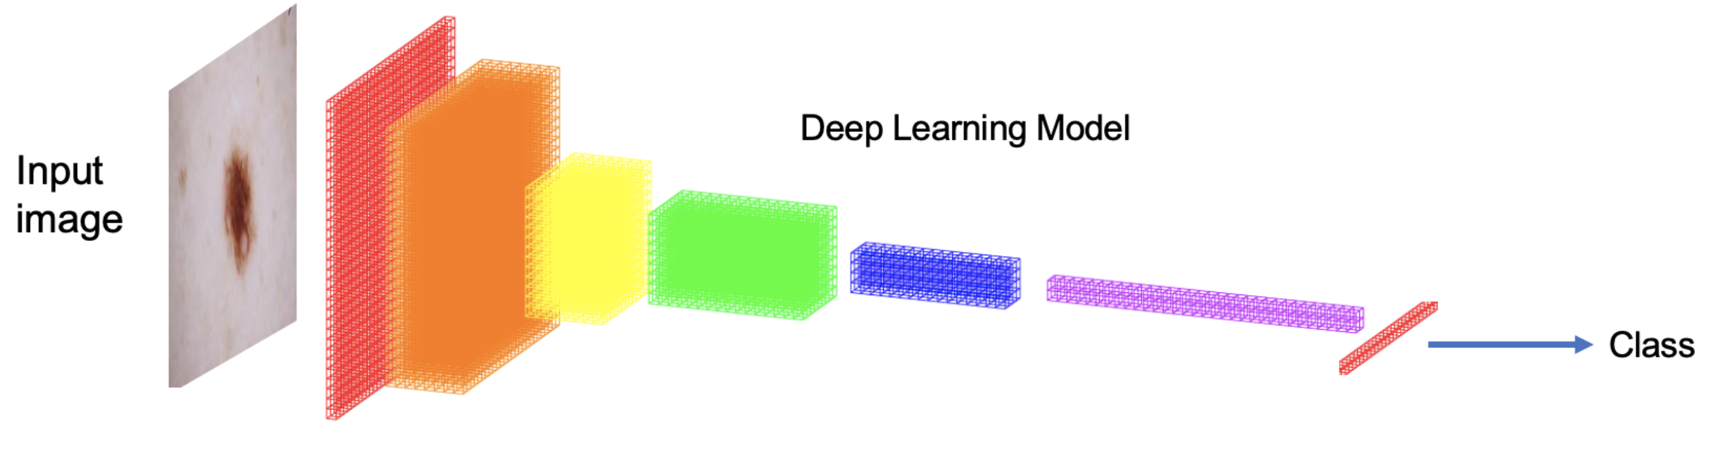
EXPERIMENTS
Skin Lesion Recognition
Datasets
ISIC (International)
AR (Argentina)
CL (Chile)
5250 samples / dataset
1050 samples / class

Slide 11
RESULTS
TESTING WITH
 | Full | ISIC | AR | CL
Full
ISIC
AR
CL
Swarm
TRAINING WITH

Slide 12
RESULTS
TESTING WITH
 | Full | ISIC | AR | CL
Full | 0.6469 | 0.7190 | 0.6905 | 0.5952
ISIC
AR
CL
Swarm
TRAINING WITH

Slide 13
RESULTS
TESTING WITH
 | Full | ISIC | AR | CL
Full | 0.6469 | 0.7190 | 0.6905 | 0.5952
ISIC |  | 0.6810
AR |  |  | 0.7619
CL |  |  |  | 0.4429
Swarm
TRAINING WITH

Slide 14
RESULTS
TESTING WITH
 | Full | ISIC | AR | CL
Full | 0.6469 | 0.7190 | 0.6905 | 0.5952
ISIC |  | 0.6810
AR |  |  | 0.7619
CL |  |  |  | 0.4429
Swarm |  | 0.8095 | 0.8333 | 0.6762
TRAINING WITH

Slide 15
RESULTS
TESTING WITH
 | Full | ISIC | AR | CL
Full | 0.6469 | 0.7190 | 0.6905 | 0.5952
ISIC | 0.5728 | 0.6810 | 0.6048 | 0.4000
AR | 0.4810 | 0.3524 | 0.7619 | 0.3667
CL | 0.3952 | 0.4095 | 0.3619 | 0.4429
Swarm | 0.5222 | 0.8095 | 0.8333 | 0.6762
TRAINING WITH

